Slide 1

Capstone Project Play Store App Review Analysis (Exploratory data analysis)
Team Members:
Kumar Abhinav
Saumya Dash

Slide 2
Content
Introduction
Data Pipeline
Exploring Dataset
Attribute Information
Problem Statement
Data Cleaning and Handling
Data Visualization
Key Insights
Conclusion/Recommendations

Slide 3
Introduction
Google Play, also branded as Google Play Store, is a digital distribution service operated and developed by Google. It is the official distribution storefront for Android applications and other digital media, such as music, movies and books etc. The Play Store apps data has enormous potential to drive app-making businesses to success. Each instance in the dataset contains information such as name of the apps, categories, genres, number of installs, size of the app, date of last update, reviews, sentiment polarity etc. Actionable insights can be drawn for developers to work on and capture the Android market. We are here to explore a play store-review dataset to discover key factors responsible for app engagement and success.

Slide 4
Data Pipeline
Import Libraries
Loading the Dataset
Exploring the Dataset
Data Cleaning and Handling
Data Wrangling
Data Visualization
Finding Insights
Conclusion

Slide 5
Exploring Dataset
There are two datasets used in our analysis: Play Store dataset and User-Review dataset.
The Play store dataset contains 10,841 rows and 13 features and the User reviews dataset contains 64,295 and 5 columns.
The columns in the dataset are App, Category, Rating, Reviews, Size, Installs, Type, Price, Content Rating, Genres, Last Updated, Current Version, Android Version.
The columns in the User Reviews dataset are App, Translated Review, Sentiment, Sentiment Polarity and Sentiment Subjectivity.

Slide 6
Exploring Dataset
There are 4 columns in both the dataset which contains null values i.e Rating, Current Version, Android Version, Type and Content Rating in 1st dataset and Translated Review, Sentiment, Sentiment Polarity, Sentiment Subjectivity.
All the columns in the Play store dataset are of object datatype except for Ratings with float values in the 1st dataset.
All the columns are of object data type except Sentiment Polarity and Sentiment Subjectivity with float64 datatype.

Slide 7
Attribute Information
App: Name of the application
Category: Name of the broad category the app falls under.
Rating: Average user Ratings on a scale of 0 to 5.
Reviews: Total number of reviews on each app.
Size: Size of the app in Megabytes and Kilobytes (represented as M and K in the dataset respectively).
Installs: Total number of downloads for each app.
Type: Label stating whether the application is free or paid
Content Rating: Audience for which the content of the app is intended for such as Teen, Mature, Everyone etc.

Slide 8
Attribute Information
Genres: Groups according to the characteristics is the Genres. This column includes various Genres to which the app belongs.
Last Updated: Date on which the app was last updated.
Current Ver: Current android version of the app.
Android Ver: The Android operating system the app is compatible with.
Translated_Review: Customer reviews written in text.
Sentiment: The sentiment of the review, positive, negative or neutral.
Sentiment_Polarity: The sentiment in numerical form ranging from -1.0 to +1.0.
Sentiment_Subjectivity: The measure of expression of opinion, evaluation, feeling and speculation.

Slide 9
Problem Statements
Which Category has the maximum and lowest number of apps ?
Which is the most popular category among the users?
Is there any disparity in app installs and number of apps present in each category?
How each category of apps perform in terms of customer sentiments?
Comparison between the apps present in the market and number of installations based on Content Rating.
What are the top 10 apps that is mostly installed.
What is the ratio of free and paid apps in each category.
What is the category wise distribution of average ratings.
What percentage of apps is supported in higher Android Versions?
Which are the top 10 Genres in terms of app availability?

Slide 10

Cleaning and Handling Dataset
Drop duplicated instances from both the Data Frames.
We have used the drop duplicate method to eliminate duplicate rows and instances from the dataset in order to prevent errors in calculation and double counting of the data.

Slide 11
Cleaning and Handling Dataset
Drop or Substitute null values
Rating column had maximum number of null values i.e.1474 which was filled by 0.
Converting the Reviews column into integer datatype after checking for Nan and replacing it with zero .
The instances with null values in Content Rating and Type columns were dropped from the data frame.
Replaced null values in Current Version with the mode(most frequent current version) i.e. ‘Varies with device’
Replaced null values in Android Version with the mode(most frequent android version) i.e. ‘4.1 and up’.
Dropped null values of the User Reviews dataframe.

Slide 12
Cleaning and Handling Dataset
Converting to suitable data types
Price column have ‘$’ for each prices. To convert it into numerical variable we substituted $ with an empty string “ ”.
Installs column have ‘+’, ‘,’ for each installs which was replaced by an empty string ‘ ’ and then converted into float datatype.
Size columns had values in megabytes(M) and kilobytes(k) which was first converted into kilobytes and then finally converted into float datatype.

Slide 13
Cleaning and Handling Dataset
Drop or replace wrongly entered data
Rating variable had a wrongly entered average rating of 19 (ratings greater than 5 is not possible) which was replaced by 0.
Price variable had a wrongly entered data i.e. ‘Everyone’ which was replaced by 0 and the variable was converted into a float datatype.
Installs variable had a wrongly entered data i.e. ‘Free’ which was replaced by 0.

Slide 14
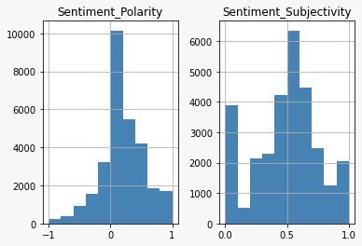
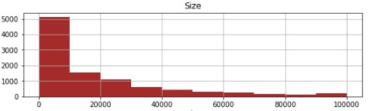
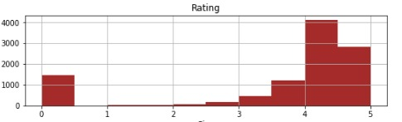
Data Visualization Univariate Analysis
The Histograms of each numerical variables represents the distribution of the data.
For example: Most of the Ratings lies between 4 and 4.5 and since we replaced the null values with 0 we can see a slight bump near 0.

Slide 15
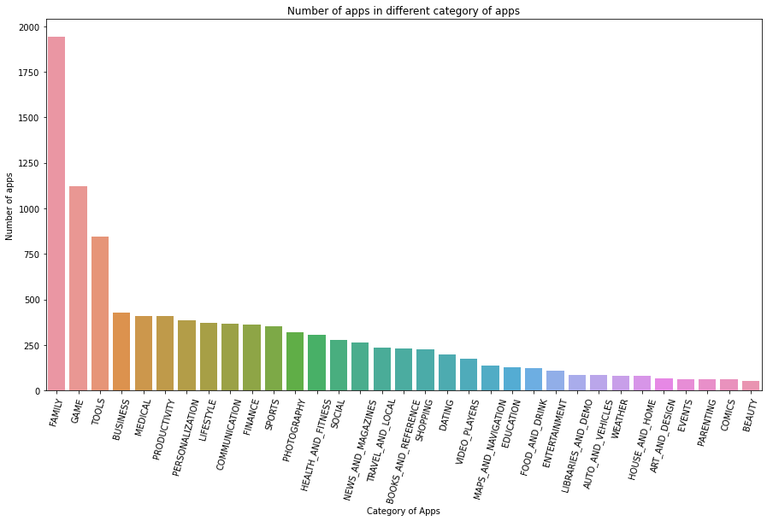
Data Visualization Problem Statement 1: Which Category has the maximum and lowest number of apps ?
1. Top three categories with greatest number of apps are:
Family
Game
Tools
2. Bottom three categories with least number of apps are:
Parenting
Comics
Beauty

Slide 16
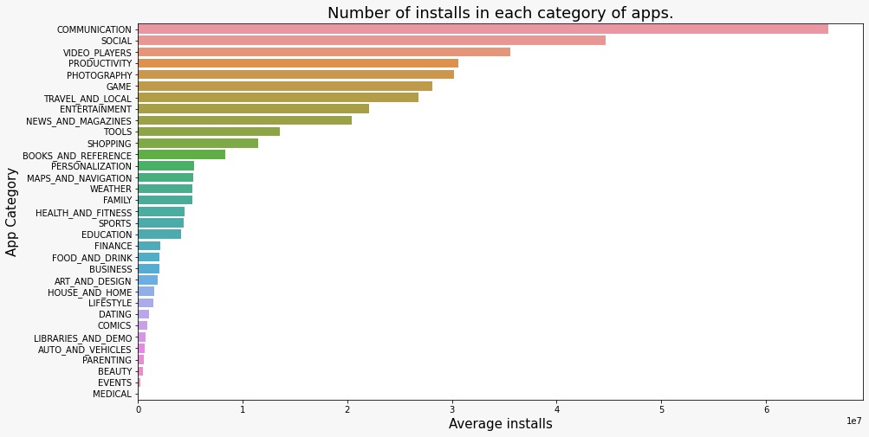
Data Visualization Problem 2: Which is the most popular category among the users?
Top three categories which have most number of downloads are:
Communication
Social
Video Players
Bottom three categories with least number of downloads are:
Beauty
Events
Medical

Slide 17
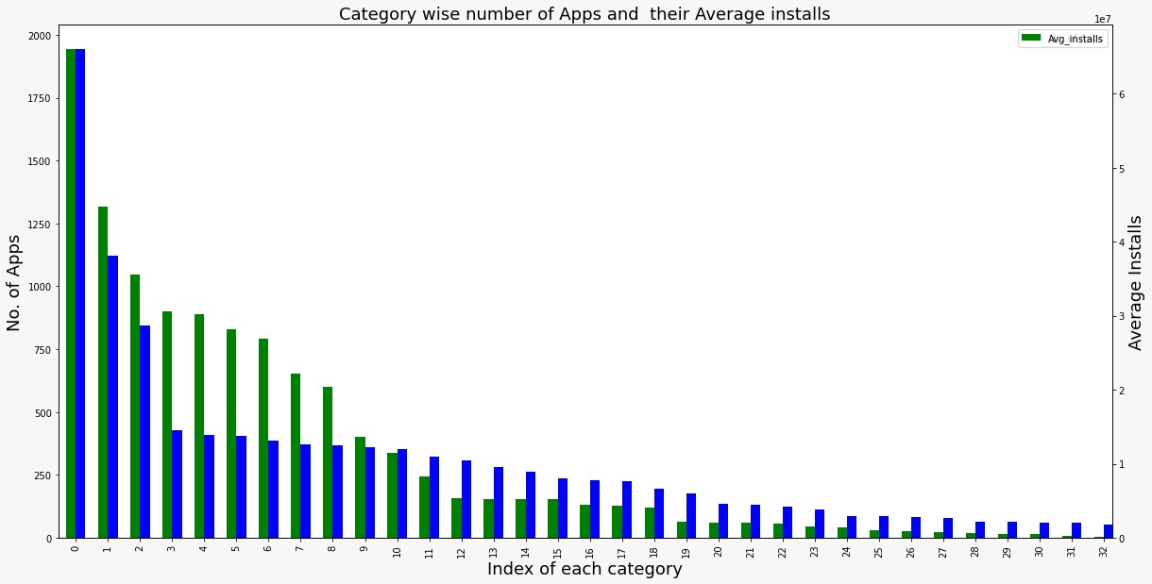

Data Visualization Problem Statement 3: Is there any disparity in app installs and number of apps present in each category?
Here, we can see that there is a disparity between the number of apps available in the market and their users in each category. For example, when compared to the quantity of apps in the market, the Medical category (Index4) has a high average installs.

Slide 18
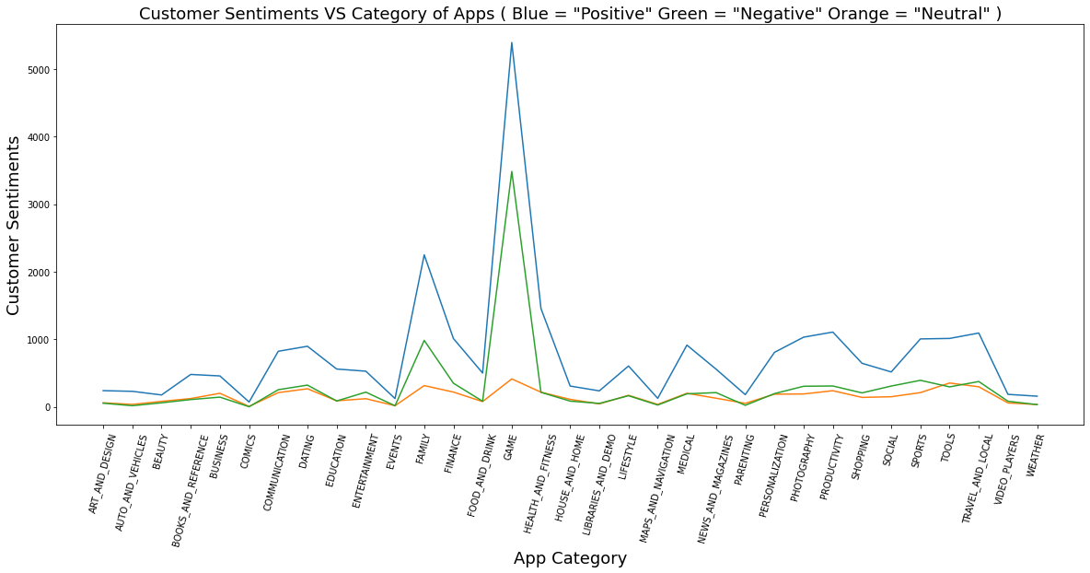

Data Visualization Problem Statement 4: How each category of apps perform in terms of customer sentiments?
Reviews for most categories are positive.
There are comparatively more negative ratings in some categories, notably Family and Games.
Comics is one of several categories with mixed sentiments

Slide 19
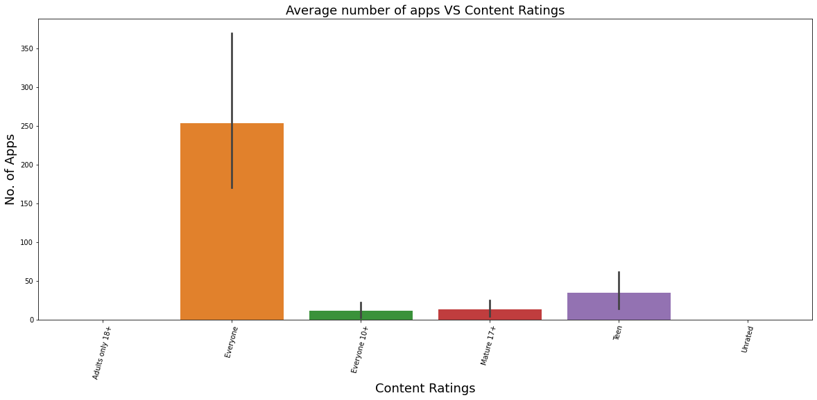
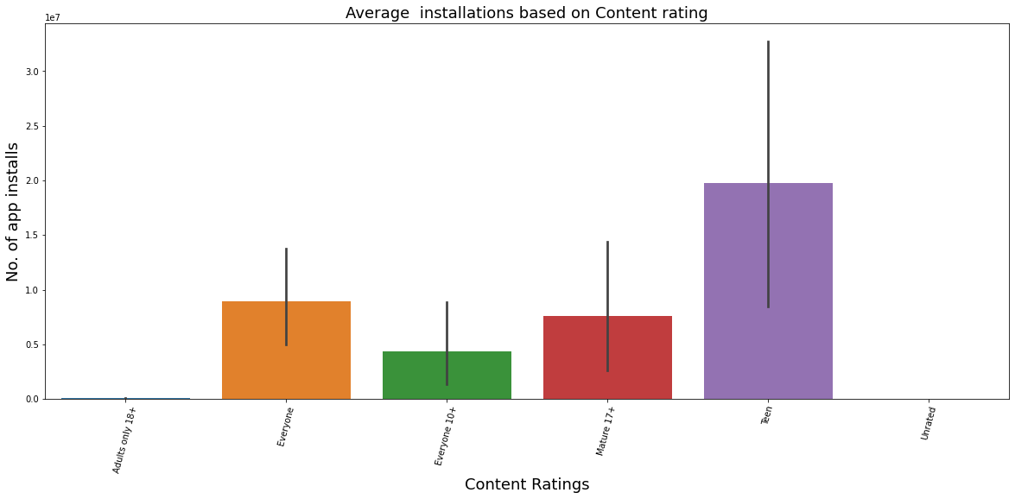
Data Visualization Problem Statement 5: Comparison between the apps present in the market and number of installations based on Content Rating.
The two graphs above show that while "Everyone" rated apps are widely available, "Teen" and "Mature 17+" rated apps have a sizable user base.

Slide 20
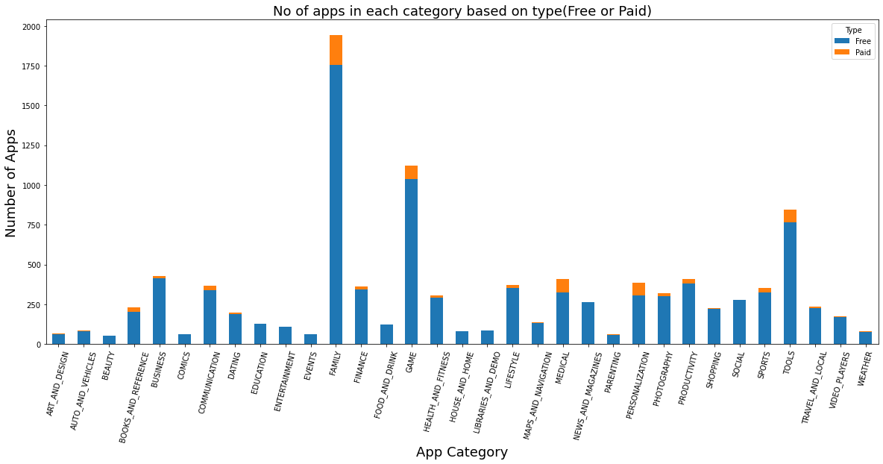
Data Visualization Problem Statement 6: What is the ratio of free and paid apps in each category.
The majority of apps are free, and family has the most number of paid apps.

Slide 21
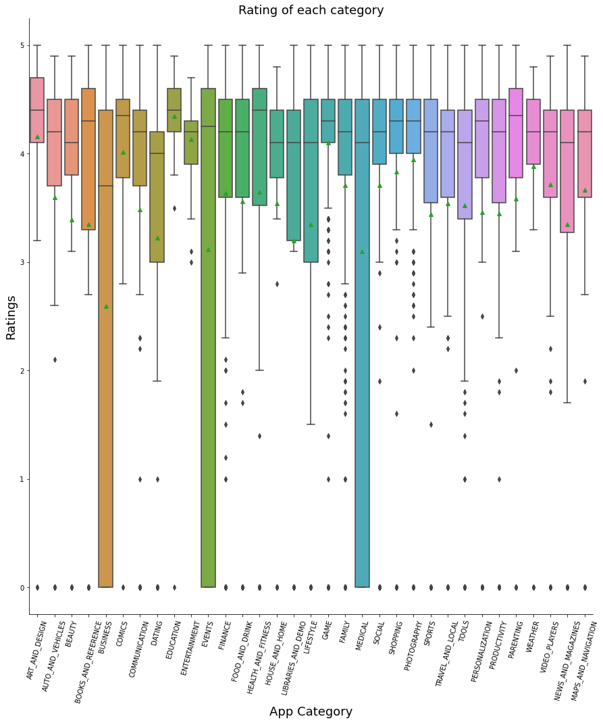
Data Visualization Problem Statement 7: What is the category wise distribution of average ratings.
The quartiles and mean of the ratings for each category are displayed in this boxplot. For instance: The mean of the average rating is roughly 2.6%, and the median (i.e., 50% of the apps) for the business category has an average rating of 3.6%.

Slide 22
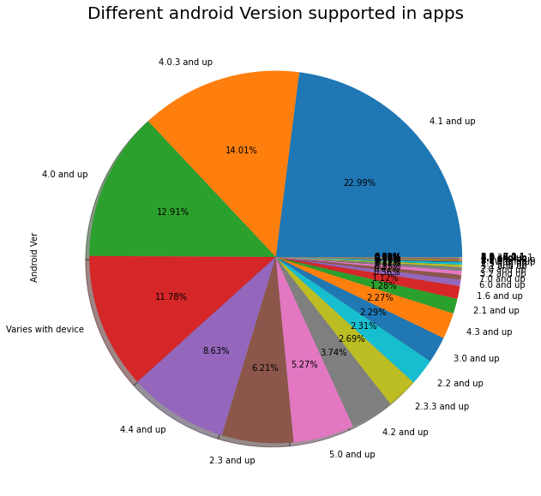
Data Visualization Problem Statement 8: What percentage of apps is supported in higher Android Versions?
According to the pie chart, over 60% of the apps are compatible with Android 4.0 and higher, while the remaining 40% require updating.

Slide 23
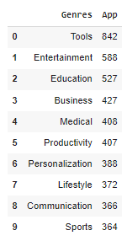
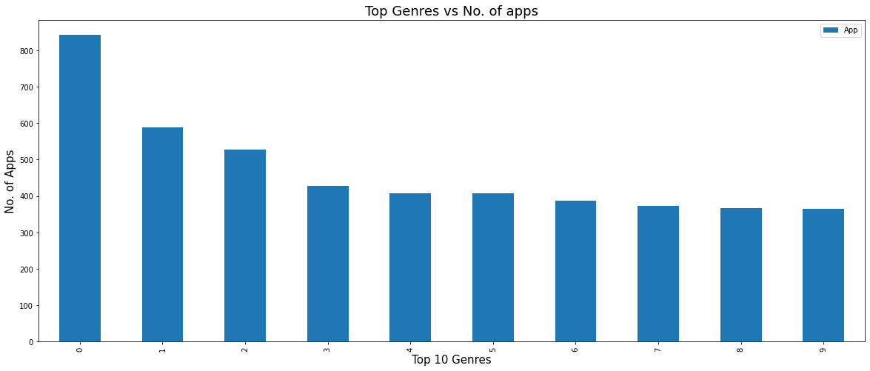
Data Visualization Problem Statement 9: Which are the top 10 Genres in terms of number of apps?

Slide 24
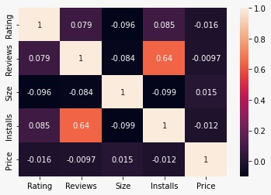
Data Visualization Problem Statement 10: Is there any correlation among numerical columns ?
This Heatmap displays the correlation between the numerical columns. As we can see, there is a high positive correlation between installs and reviews, meaning that more favorable reviews lead to more app installations. Reviews should therefore be regarded as one of the crucial elements influencing app downloads.

Slide 25
Key Insights
Most of the Ratings lie between 4 and 4.5.
Top three categories which have most number of apps are Family, Game & Tools and bottom three categories are Parenting , Comics & Beauty.
Top three categories which have most number of downloads are Communication, Social, Video Players and bottom three categories are Beauty, Events and Medical.
There is a gap in the market as far as the number of apps available in the market and their users in each category are concerned.
Reviews for most categories are positive in comparison to negative and neutral sentiments
The highest number of apps available is for "Everyone" type of audience but “Teen” and “Mature 17+” rated apps are widely downloaded.

Slide 26
Key Insights
Top 10 genres with highest number of apps are Tools, Entertainment, Education, Business, Medical, Productivity, Personalization, Lifestyle, Communication, Sports.
Reviews and installs have a strong positive correlation of 0.64.
The majority of apps are free, and “family” has the most number of paid apps.
Over 60% of the apps are compatible with Android 4.0 and higher, while the remaining 40% require updating.

Slide 27
Conclusions
Some of the Categories like Communication, Social Media , Video Player and Gaming have a significant market gap as they are high in demand among users but there are a very few apps to fulfill this gap. So there is huge opportunity to expand business in these categories.
Gaming is one of several categories which is popular among both the users and the service providers. However, it is observed that there are some negative sentiments among the users for this category. Therefore, Gaming firms need to improve their services and provide customers a hassle-free experience.
Play store has the most apps with content that is rated for everyone, however users prefer to download teen and mature (17+and more) rated apps. There is therefore a room to develop a business around it.
There is room to establish a business on a monthly or yearly subscription model because there aren't many paid apps in the app store. Ed-tech, gaming, and entertainment have a lot of potential in this area.

Slide 28
Thank You!!
The End of a Story…..
The Beginning of Many

